Slide 1
Convolutional Neural Network
Syed Wajeeh Ul Hassan
wajeehul.hassan.311@gmail.com

Slide 2
Convolutional Network Layers
CNN use filters and pooling and it automatically detect the important feature without any supervision of human. It used for pattern detection, image recognition etc.
Convolutional Layer
Pooling Layer
Fully-Connected Layer

Slide 3
Convolutional Layers
What is Convolution?
$$h1=f\left(a∗w1+b∗w2+e∗w3+f∗w4\right)$$
a | b | c | d
e | f | g | h
i | j | k | l
m | n | o | p
w1 | w2
w3 | w4
h1 | h2
Input Image
Filter
Convolved Image
(Feature Map)
$$h2=f\left(b∗w1+c∗w2+f∗w3+g∗w4\right)$$
Number of Parameters for one feature map = 4
Number of Parameters for 100 feature map = 4*100

Slide 4
Lower Level to More Complex Features
w1 | w2
w3 | w4
w5 | w6
w7 | w8
Filter 1
Filter 2
Input Image
Layer 1 Feature Map
Layer 2 Feature Map
In Convolutional neural networks, hidden units are only connected to local receptive field.

Slide 5
Pooling
Max pooling: reports the maximum output within a rectangular neighborhood.
Average pooling: reports the average output of a rectangular neighborhood.
MaxPool with 2x2 filter with stride of 2
1 | 3 | 5 | 3
4 | 2 | 3 | 1
3 | 1 | 1 | 3
0 | 1 | 0 | 4
4 | 5
3 | 4
Input Matrix
Output Matrix

Slide 6
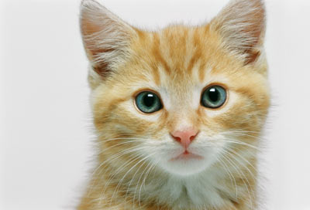
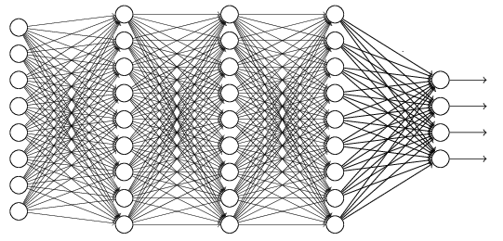
The whole CNN
cat dog ……
Convolution
Max Pooling
Can repeat many times
Fully Connected Feedforward network
Convolution
Max Pooling
Flattened

Slide 7
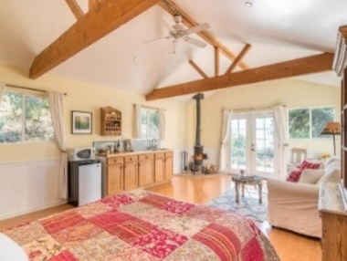



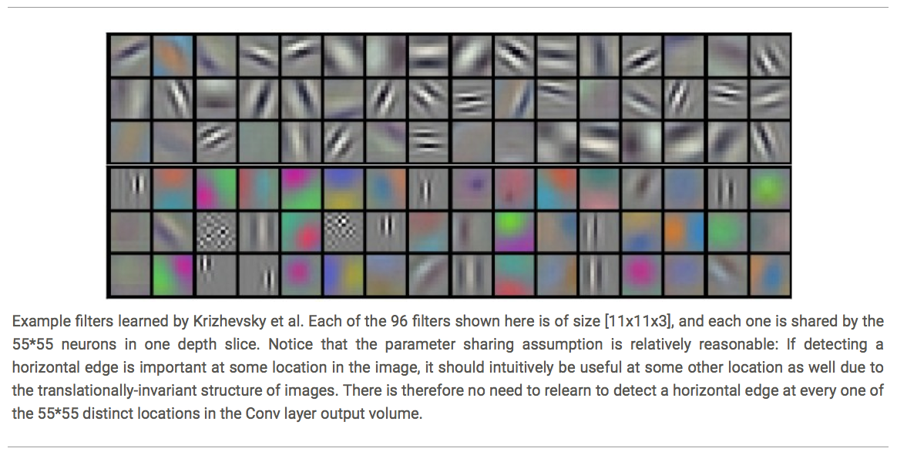













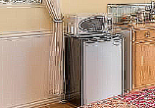


Deep Learning
Deep learning has an inbuilt automatic multi stage feature learning process that learns rich hierarchical representations (i.e. features).
Low Level Features
Mid Level Features
High Level Features
Trainable Classifier
Output
(e.g. outdoor, indoor)

Slide 8
Fine Tunning CNNs
Finetuning means removing the middle layers of feature extraction and directly go to the last layer. In simple taking advantages of trained neural network by using its weights and initialized it for new model of same domain.
In simple words a child first learn from letters when he grow he learn from words same is the case. The data is pretrained and finetuning just learn from already given data or common data.

Slide 9
Acknowledgements
Material of these slides has been borrowed from multiple sources including:
Intro to Deep Learning 2021: MIT
CNN Lectures of 2017: Waterloo University, Canada
Deep Learning Slides: Carnegie Melon University
Machine Learning @ Berkeley
Nikhil Budhuma, Fundamentals of Deep Learning

